Slide 1
October 19, 2017 Carmen Connect Webinar
Audio – 1-877-820-7831 code:484159#

Slide 2
Housekeeping Items
All lines will be muted
*6 to unmute your line to ask a question
*6 to mute your line after you are done speaking
The leads will be monitoring the questions via the chat boxes, please feel free to ask questions there.

Slide 3
Agenda
PSSC Staff updates
Travel Pilot
Pcard and Asset Management updates
Amazon Accounts
PSSC update

Slide 4
Website
http://u.osu.edu/pssc
Staffing
Kelly Moore - Out until January 2nd
Terrance Jr born October 12
New Position Posted – Sr. Finance Coordinator (replaces the open Finance Coordinator position)
Plan to promote and internal PSSC staff member to this position
Will assist with the Lead approvals as well as supervising a Finance Assistant
New Position Posted soon – Finance Assistant (replaces opening created by the Sr. Finance coordinator)
Will assist the Sr. Finance coordinator with transaction processing and customer service
New Position Posted Soon – Team Lead (will fill the gap during Kelly’s absence)

Slide 5
Next Call
November 16, 2017 @ 10:00 AM
Switching to Skype Meeting with Skype phone #

Slide 6
Travel Updates
Pilot Overview

Slide 7
Travel Pilot Mandate
Who is participating in the Travel Pilot supported by PSSC?
Office of Academic Affairs
Office of Student Life
John Glen College
Office of Human Resources
College of Law
Office of Business & Finance

Slide 8
Notes:
Brief introduction about the Strategic Plan.
Released by President Drake in late August 2017.
Embarking on a plan to strive for operational excellence
Includes multiple spend categories where administrative efficiencies can be found (e.g. computers, furniture and travel)

Slide 9
About Ohio State’s Strategic Plan – Travel
Enterprise-wide requirement of 1 travel agency for business travel
Enterprise-wide requirement of 1 rental car contract for business travel
Improve service and reduce administrative costs
Notes:
Goal of mandate: devote our time and resources to our core academic mission.
Secure improvements with duty of care
Improve Service
Reduce administrative costs

Slide 10
Benefits
 | Duty of Care |  | Visibility to Spend
 | No Out-of-Pocket |  | Discounts at Booking
 | One Stop Shopping
Notes:
Increased visibility to the university to aid in identifying the location of its travelers in the event of natural or political events that may affect the traveler’s safety and well-being.
University payment methods available to cover air, hotel and rental car reservations.
One easy point of contact for all travel sourcing, planning and booking; 24/7 – 365 days/year
Permits full visibility to activity and spend to plan, negotiate and implement change more strategically
4 major airlines, multiple hotel and rental car discounts applied at booking
Personal travel discounts available to active faculty, staff and students.

Slide 11
About the Travel Pilot
Goal: Fine-tune and validate service delivery
Pilot Participants:
College of Engineering
College of Food, Agricultural & Environmental Science
College of Law
Business & Finance
Office of Academic Affairs, HR & John Glenn
Student Life
Training: Starts October 6-October 13
Duration: Effective October 16-November 30
Notes:
35% Indv business traveler using CTP for airfare, the pilot is just influencing more engagement toward the requirement

Slide 12
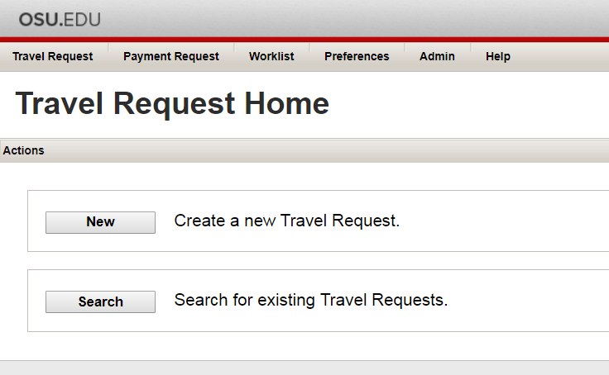
During the Pilot – What’s different?
Must have Travel Authorization (T#) prior to booking
Check with your Service Center for assistance
Notes:
eTravel – OSU built system that documents authorization and expense estimates for budget purposes
Email Filters
T# (not R#) – one/trip
Service Center – internal/custom processes

Slide 13
During the Pilot – What’s different?
Airfare bookings through Corporate Travel Planners
Full Service Agents 
Concur Online Booking 
Notes:
Booking online through Concur vs airline website (Profile)
Booking online is encouraged, but you can use full service
To finalize booking, user must provide valid T#, employee ID and confirm UNIV or OSP travel

Slide 14
During the Pilot – What’s different?
Rental car reservations through Enterprise or National
CTP Agent or Concur
Enterprise/National Business Rental Tool
Notes:
No payment required at reservation – for business use only
Low rates and required insurance built in

Slide 15
Pilot Assistance & Resources
Custom Website for Pilot Participants: https://u.osu.edu/travelpilot2017/
Guides & Pilot Packet
Quick Reference Guide
Options for Booking
OSU Contact for Assistance & Feedback

Slide 16
After the pilot --- What’s Next?
KPI Review with all Pilot Areas
Focus Group Discussions
Feedback via Survey
Recommendation to Leadership
Launch university-wide January 1, 2018
Notes:
Key Performance Indicators determined to measure quality of service
Coordinate available participants to sit in focus group discussions
All participants should receive a Qualtrix survey
Compiled results will be reported to leadership – recommendation
Launch fully as a mandate January 1

Slide 17
PCard & Asset Mgt Updates

Slide 18
PCard Update
Renewal 2018
Asset Management Updates
PIER Report Deadline (8/31)
DocuSign Forms
Notes:
Goal of mandate: devote our time and resources to our core academic mission.
Secure improvements with duty of care
Improve Service
Reduce administrative costs

Slide 19
Amazon Business Accounts
Recent charges for Amazon Prime
Amazon Business Account website – http://u.osu.edu/amazonbusiness
Only Pcard managers can have an Amazon Business Account
No purchases should be made outside of the Amazon Business Account

Slide 20
“Change is inevitable…except from vending machines”-Robert C. Gallagher

Slide 21
PSSC Updates
Administration & Planning will be joining the Service Center on October 30.
Facilities Operations
Facilities Design and Construction
WOSU
Public Safety
Environmental Health & Safety
Transportation & Traffic Management
UniPrint
Planning and Real Estate

Slide 22
PSSC Updates
Kim Melchiorre and Rick Meyers will be joining our team from the Admin & Planning Service Center
As part of the transition, we will be looking at our team structure, assignments, reporting roles to align our areas of support

Slide 23
Questions?

Slide 24
Thank You!

